Slide 1
Improve Customer Service with Big Data !
Learn How

Slide 2
Agenda
At the end of the session, you will be able to know :
Rise of Big Data
Big Data and hadoop
Major companies using Hadoop
Scenarios in customer service where Big Data can help

Slide 3
Rise of Big Data
By 2020, IDC (International Data Corporation) predicts the number will have reached 40,000 EB, or 40 Zettabytes (ZB)
The world’s information is doubling every two years. By 2020, there will be 5,200 GB of data for every person on Earth.

Slide 4
Opinions about Big Data
"Data are becoming the new raw material of business"
Chris Lynch
former President and CEO Vertica Systems
“Torture the data, and it will confess to anything”
Ronald Coase
Economics, Nobel Prize Laureate
"The world is one big data problem"
-Andrew McAfee
Associate director of the Center for Digital Business
MIT Sloan School of Management
"Information is the oil of the 21st century, and analytics is the combustion engine"
- Peter Sondergaard,
Senior Vice President,
Gartner Research.
“In God we trust. All others must bring data.”
-W. Edwards Deming
statistician, professor, author, lecturer, and consultant

Slide 5
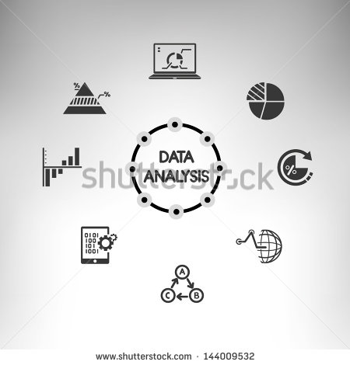
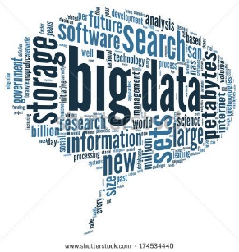

Big Data with Hadoop
Current Scenario:
Unstructured Data is Exploding
Organizations take fact based decisions
The Bigger the data, accurate is the decision!
Hadoop can digest all kinds of data and you can torture it to help you make your data driven decisions

Slide 6
















Major Companies Using Hadoop

Slide 7
How Big Data Can Improve Customer Experience?

Slide 8
Serve Before They Ask
Remember when that shopkeeper had your pack of bread and egg all wrapped up and ready to go before you even told her that’s what you wanted?
Providing that same service for every online shopper based on their past purchasing pattern to increase customer satisfaction — and increase purchases.
Right products
Right customers
Right channel
Predict the future

Slide 9




Companies using Big Data for Prediction
Amazon long ago mastered the recommendation of books, toys, or kitchen utensils that their customers might be interested in

Slide 10
Give The Customer Right View Of Their Data
By providing customers data that’s meaningful to them, companies can develop superfans.
Once customers get hooked on their own personal data, they’re more likely to continue logging in or using the product.
Customers will have become brand loyalists along the way.
E.g. The man who loves his Fuel band will perhaps buy more Nike athletic gear.

Slide 11
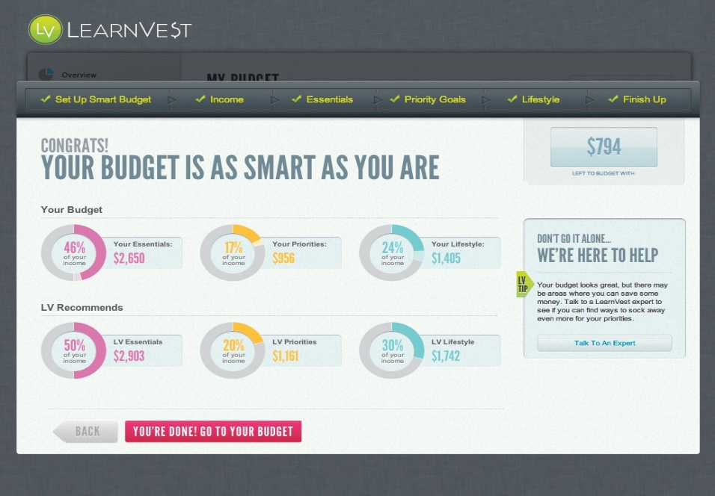
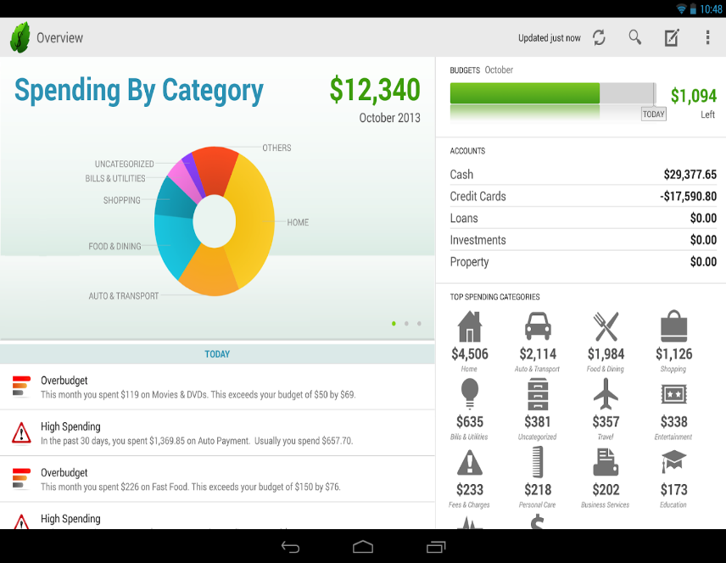
Case Study
Sites like Mint.com and LearnVest allow consumers to review their spending by category and see where their money went in a given week, month or year.
User’s spending data is continuously monitored and analyzed to find a pattern which may help user in saving money and spending smartly

Slide 12
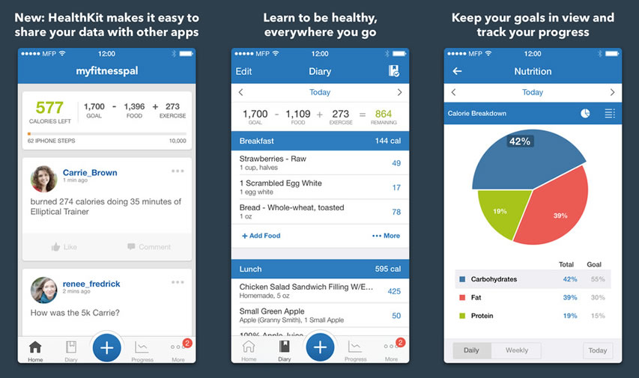
Case Study
The food diary platform MyFitnessPal gives people not only detail of how many calories they’ve consumed each day but also breaks down protein, fat, and carbs.
These companies perform analytics on the huge data generated by the user’s mobile and they show the information extracted from customer’s raw data

Slide 13
Improve The Interactions
When a customer reaches out, the representative can more quickly and efficiently solve the problem if they have the right data in front of them
They won’t need to ask as many questions of the customer because they already know the answers
Companies who equip their employees with tools that provide in-depth customer data stand apart
This helps customer service executive provide great service, which only improves with each interaction

Slide 14


Case Study
Southwest Airlines, is using speech analytics to extract data-rich info from live-recorded interactions between customers and personnel to get a better understanding of their customers.
Speech analytics help the airline to have maximum information about the customer beforehand
Whenever the customer calls his voice is organized by speech engine and his recent queries and important data displays which helps in improving the interaction

Slide 15
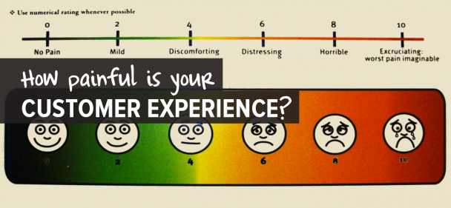
Know Customer Pain Points And Solve Them
Most companies know what some of their customers’ pain points are (if they don’t, they aren’t paying attention to their customers.)
Those who are digging deep into the data to solve those difficulties are improving their customers’ experience.

Slide 16
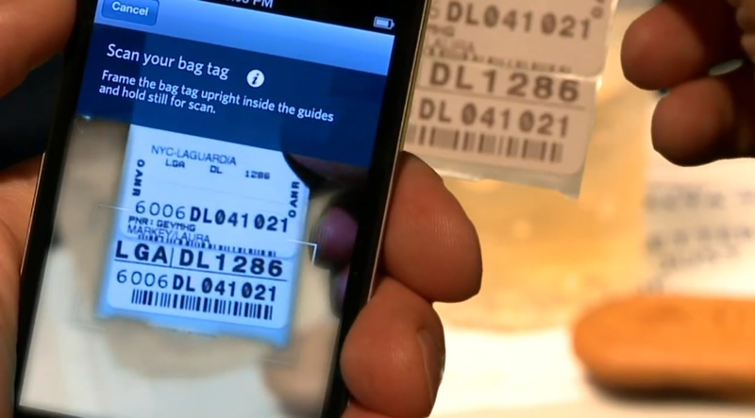
Case Study
Passenger’s lost baggage is top concern for airlines
Delta looked further into their data and created a solution that would remove the uncertainty of where a passenger’s bag might be.
Customers can now snap a photo of their baggage tag using the “Track My Bag” feature on the Delta app and then keep tags on their luggage as it makes its way to the final destination.

Slide 17

Customer Churn Prevention
Closing a sale and landing a new customer is great, but it shouldn’t be the end goal for businesses looking to foster long-term growth.
Representatives can use response times, channel analysis and categorized tags to see exactly how to help customers as quickly and efficiently as possible.

Slide 18





Customer Churn Prevention
Customer service and sales teams can combine their data to see how customer-support responses contribute directly to sales efforts.

Slide 20
Survey

